Slide 1
A generalized framework for detailed classification of swimming paths inside the Morris Water Maze
Avgoustinos Vouros
PhD researcher / Student
(14/10/2017)
Supervised by Prof Eleni Vasilaki

Slide 2
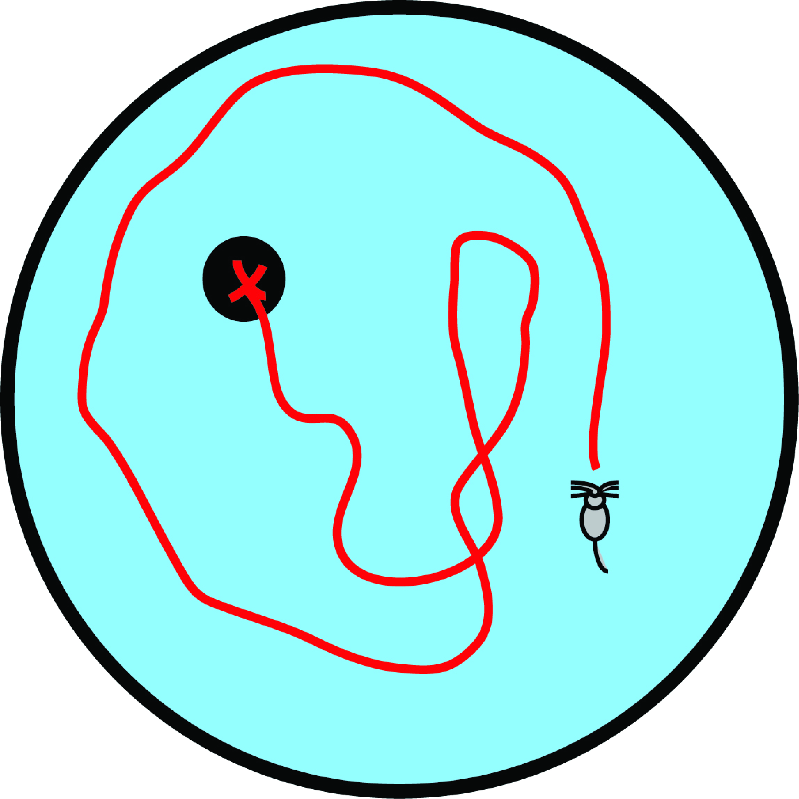

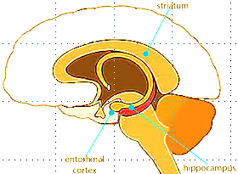
The Morris Water Maze
D days, T trials/day.
Probe trials.
Reversal trials.
Discrimination trials
ageing
nutrition
diseases
drugs
A
B
Notes:
Navigation tasks is one of the main methods on studying spatial learning and memory and most of the research on this area has been focused on various such tasks which are performed by rodents inside mazes
The preferred experimental animals for these procedures are usually rodents and specially rats and mice because of their anatomical, physiological and genetic similarities to humans.

Slide 3
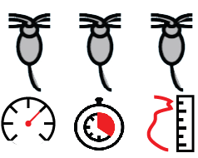
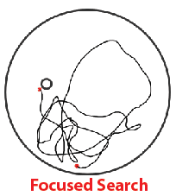
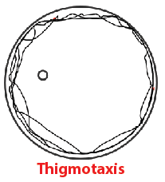
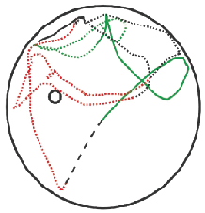
Data Analysis in the Morris Water Maze
Performance
Measurements
Trajectories
Classification
Detailed
Trajectories
Classification (Gehring et al.)
T. V. Gehring, G. Luksys, C. Sandi, E. Vasilaki, Detailed classification of swimming paths in the morris water maze: multiple strategies within one trial,“ Scientic reports, vol. 5, 2015.
Notes:
Easy to use, generalize. | Quantification issues.
Far more informative about the actual animal behaviours. | Complex, subjective, ML knowledge.
Ability to detect more differences between animal groups. | More complex, subjective, ML knowledge.

Slide 4
Gehring et al. Procedure
Segmentation
Features
Labelling?
Classification
Segmentation configuration?
Labels
Number of
clusters
Classification tuning?
Validation criteria,
graphs, statistics…
Results
Complex
Machine learning knowledge
Robustness?
Generalization?

Slide 5
Can we have something:
More easy to use?
Super robust
Minor to none tuning
Confident about our analysis

Slide 6

New Procedure
Classification
Algorithm
K
Cross
Validation
Multiple
Ks
Pool
of
Classifiers
Classifier 2
Classifier 1
Classifier N
Results

Slide 7
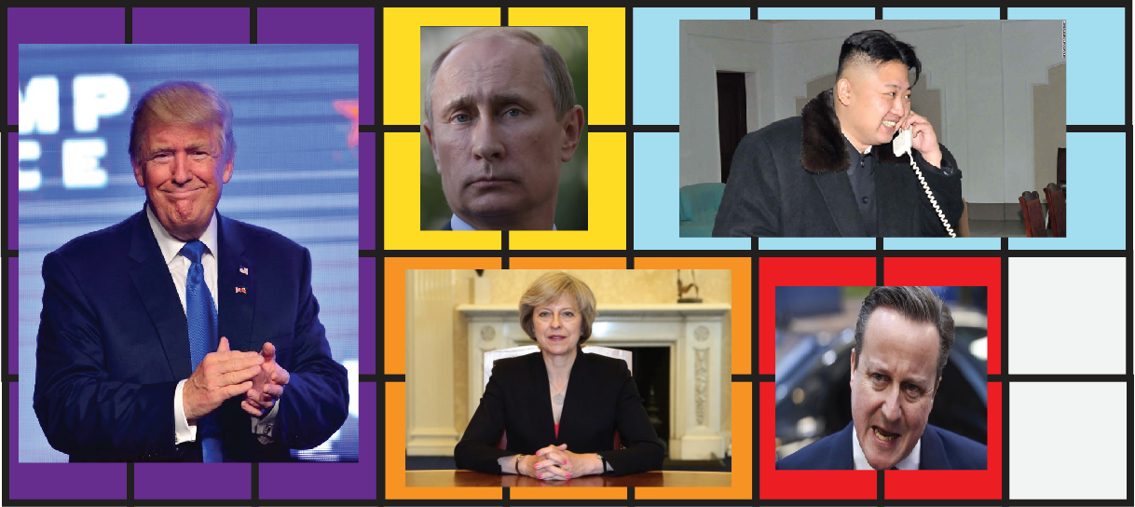
Do we trust this voting system?
Results = Robust?
Conclusions = Confident?

Slide 8

Classifiers Ensembles
Pool
of
Classifiers
Results
Results
Results
Results
Results
Results
Conclusions

Slide 9
Labelling Revised
Labelling
Unfortunately rule of the thumb:
8% ~ 12% of the data needs to be labelled…
But now we can assess the
labelling quality!
a) Agreement percentage (75%)
b) Unclassified percentage (10%)

Slide 10
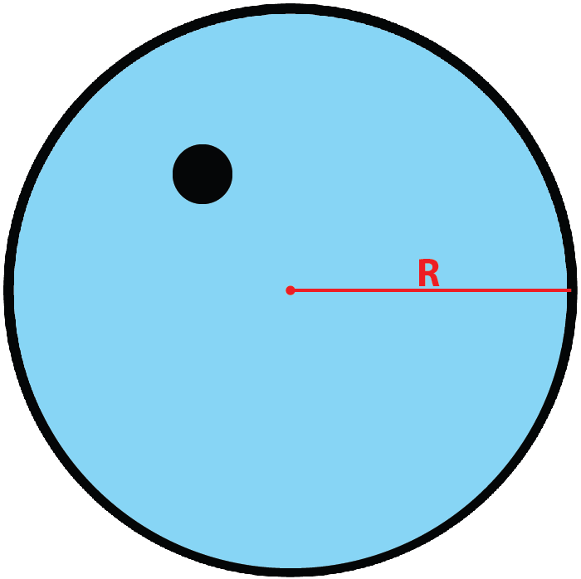
Segmentation Revised
Segmentation
Segment length proportional to the arena dimensions.
Empirically:
segment length = 2R ~ 2.5R

Slide 11
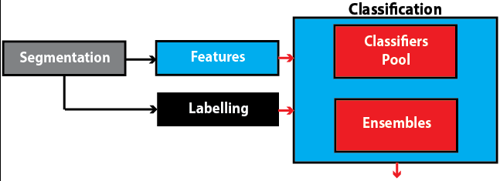
Summary
For each of 8 strategies: is there significant difference between the two animal groups?
Ensembles: agreement percentage (75%).
Ensembles: percentage of unclassified segments (10%).

Slide 12
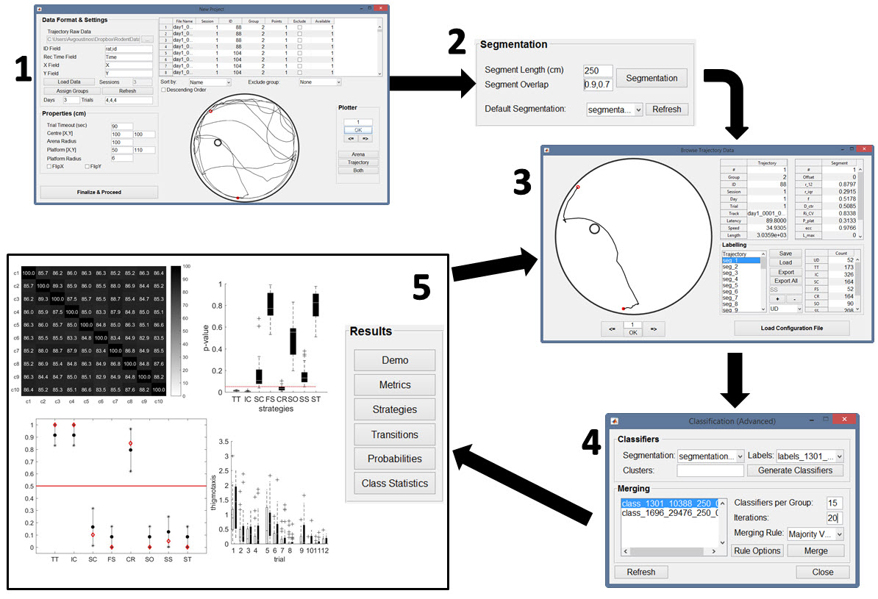
Software
Currently in use by researchers and collaborators of the Nencki Institute of Experimental Biology in Warsaw, Poland.

Slide 13
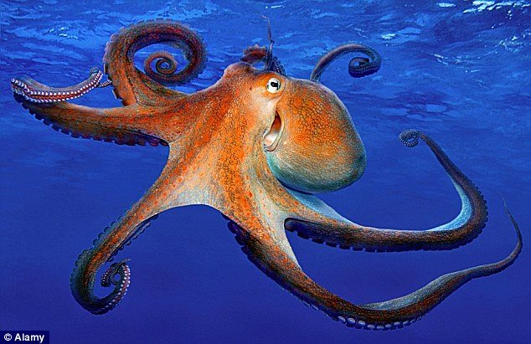
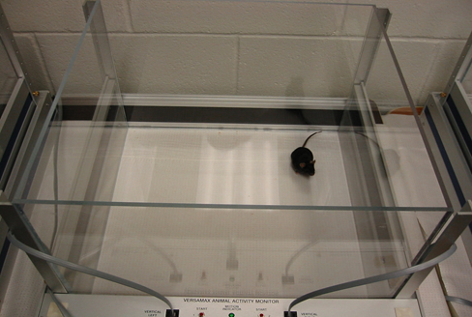
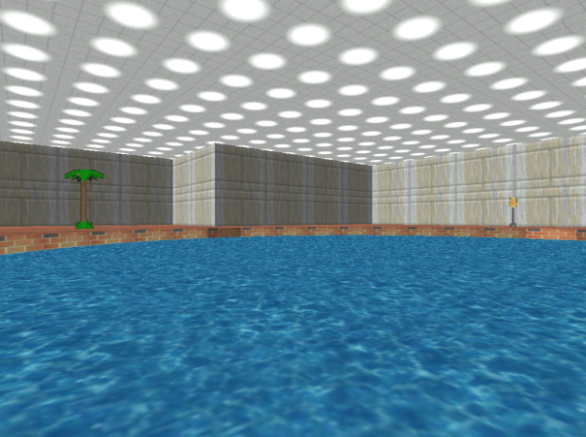
But why do we care so much?

Slide 14
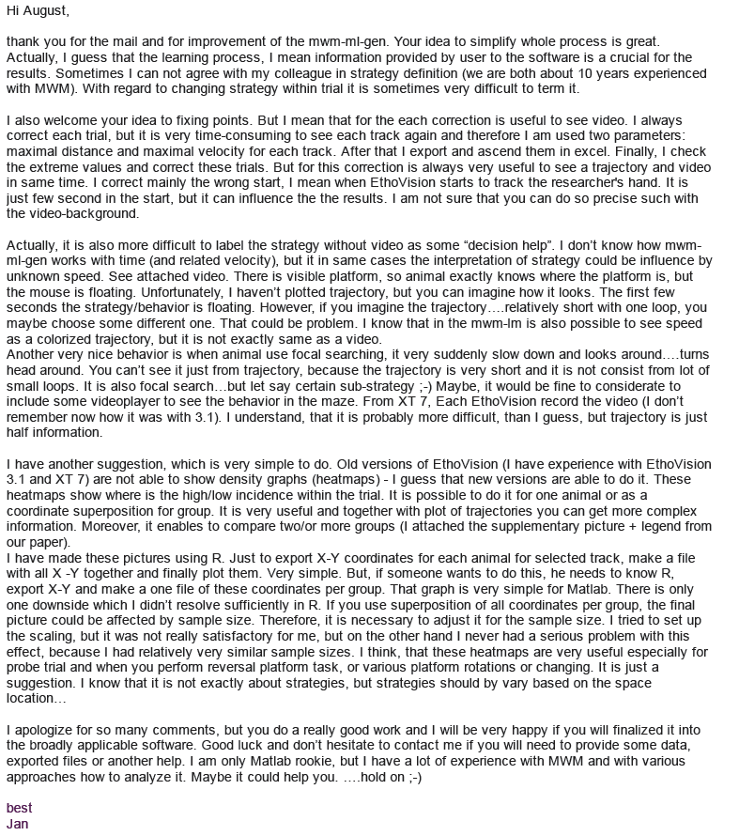




But why do we care so much?

Slide 15
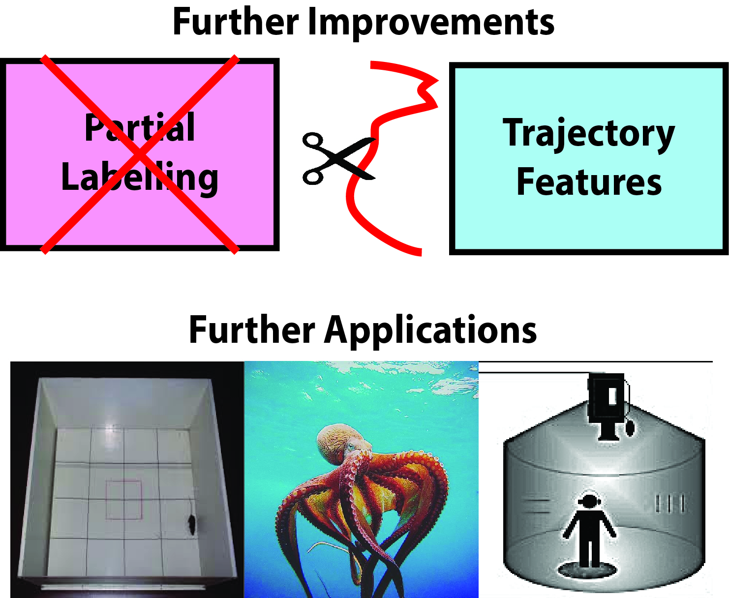
Future Plans

Slide 16
Thank you for your attention!

Slide 17
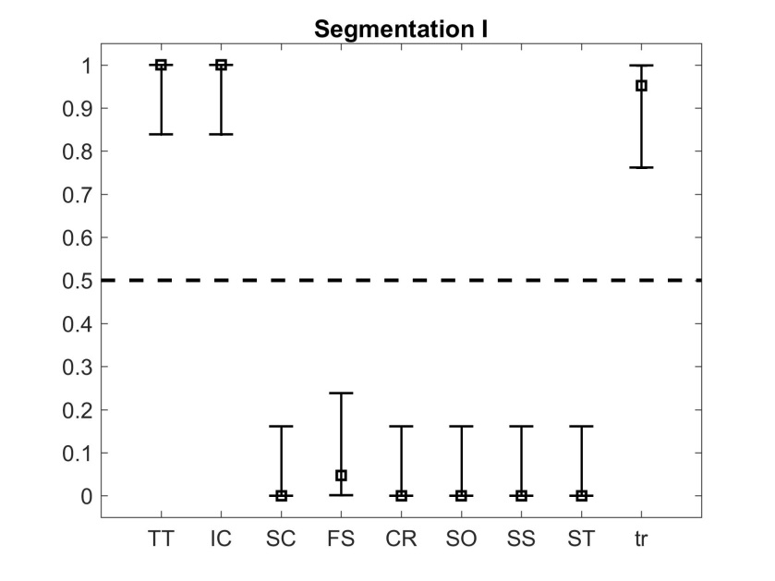
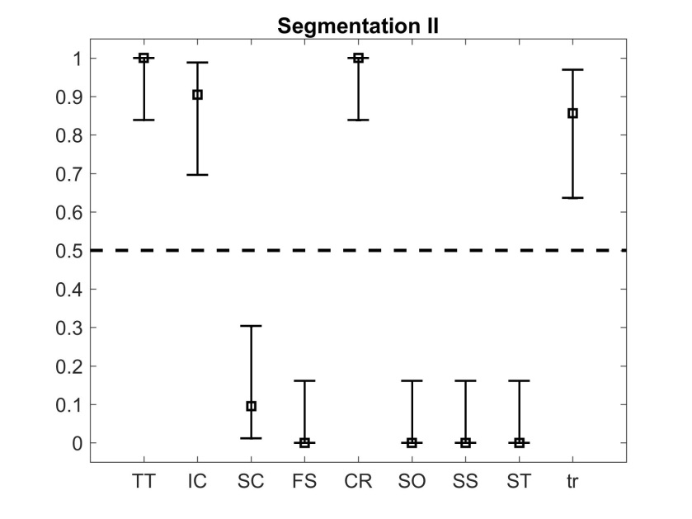
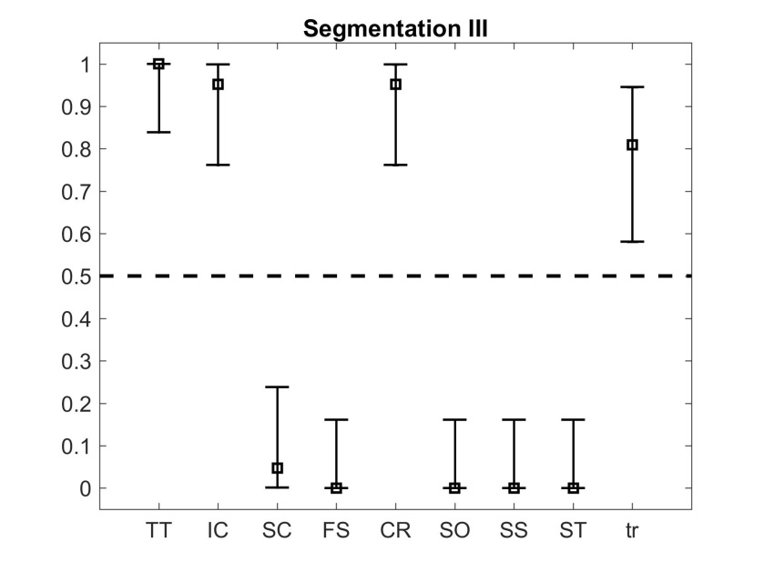
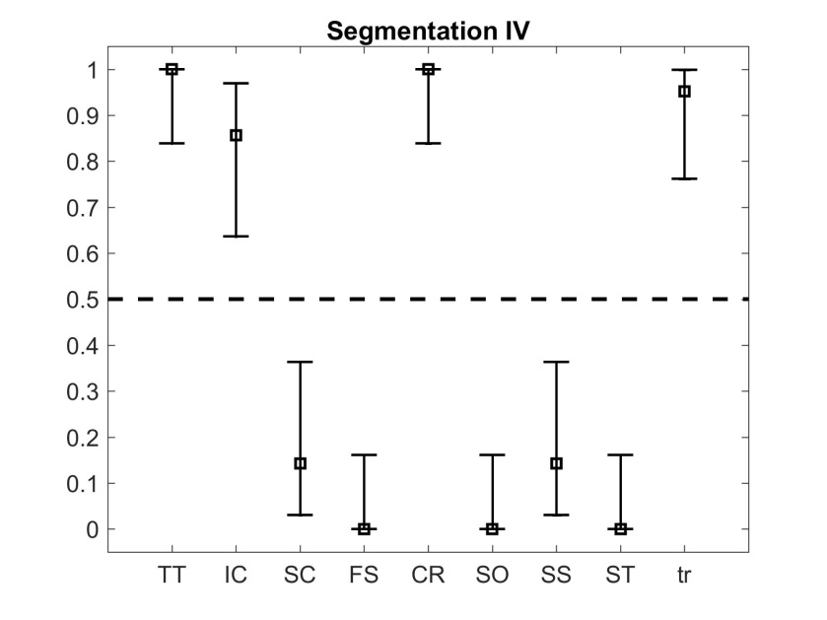
Friedman test + Confidence Intervals

